Slide 1
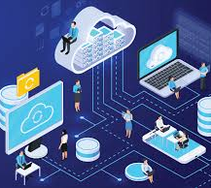

What is cloud computing

Slide 2
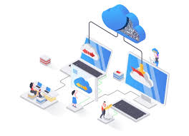
What is cloud computing…?
Think of it as renting what you need instead of owning it.
Example: Instead of buying your own storage device, you use services like Google Drive or Dropbox to store your files online and access them from anywhere.
Cloud computing works similarly but with computers, storage, and software. Instead of owning physical hardware and managing everything yourself, you rent computing power, storage, and services from companies like Amazon Web Services (AWS), Microsoft Azure, or Google Cloud.

Slide 3
Comparing traditional IT to Cloud computing
Aspect | Traditional IT 🖥️ | Cloud Computing ☁️
Infrastructure | Own servers 🏢 | Shared resources 🌎
Setup Time | Long ⏳ | Quick ⚡
Cost | High upfront 💸 | Pay-as-you-go 💳
Scalability | Limited 📏 | Flexible 📈
Maintenance | Manual 🔧 | Handled by provider 🤝
Access | On-premise 🏠 | Anywhere with internet 🌐
Disaster Recovery | Risk of data loss ⚠️ | Built-in backup 🛠️
Software Updates | Manual installation 🛠️ | Automatic updates 🔄
Energy Use | High power consumption 🔋 | Optimized by provider 🔌

Slide 4
Aspect | Traditional IT | Cloud Computing
Infrastructure | Requires physical servers, data centers, and hardware. | Uses virtual servers and shared resources over the internet.
Upfront Cost | High upfront investment for hardware, software, and setup. | Pay-as-you-go pricing with little to no upfront cost.
Scalability | Scaling requires buying and installing new hardware. | Instantly scalable up or down as needed.
Maintenance | Businesses handle hardware updates, repairs, and software. | Maintenance is handled by the cloud provider.
Accessibility | Limited to on-site access or complex VPN setups. | Accessible anywhere with an internet connection.
Deployment Time | Can take weeks or months to deploy new systems. | Services can be deployed in minutes.
Flexibility | Less flexible, tied to purchased hardware and software. | Highly flexible with a variety of services and configurations.
Disaster Recovery | Requires dedicated resources for backups and recovery plans. | Built-in disaster recovery options are often available.
Energy Efficiency | Requires energy to run and cool physical servers. | Providers optimize energy usage across shared infrastructure.
Skill Requirements | Needs in-house IT staff for maintenance and troubleshooting. | Limited in-house IT skills needed; provider manages most tasks.

Slide 5
Benefits of using cloud computing
1. Cost Savings 💰
No need for expensive hardware, physical infrastructure, or maintenance.
Pay-as-you-go model ensures you only pay for what you use.
2. Scalability 📈
Easily scale resources up or down based on demand.
Perfect for businesses with fluctuating workloads.
3. Accessibility 🌐
Access your data and applications from anywhere with an internet connection.
Encourages remote work and collaboration.
4. Performance ⚡
Cloud providers offer high-speed networks and efficient data centers.
Ensures minimal latency and maximum uptime.
5. Reliability 🤝
Built-in disaster recovery and backup solutions reduce the risk of data loss.
High availability and redundancy across servers.

Slide 6
Benefits of using cloud computing continue
6. Security 🔒
Advanced security features such as encryption, firewalls, and access controls.
Continuous monitoring to detect and prevent cyber threats.
7. Automatic Updates 🔄
Providers handle software and hardware updates, ensuring you’re always using the latest technology.
8. Environmental Benefits 🌱
Optimized resource sharing reduces energy consumption and carbon footprint.
9. Innovation 🚀
Access to advanced technologies like AI, machine learning, and big data analytics without heavy investments.
10. Flexibility 🛠️
Variety of services (e.g., storage, computing power, databases) tailored to different needs.
Multi-cloud and hybrid solutions offer more customization.

Slide 7
Types of Cloud Computing
1. Deployment Models: cloud deployment model identifies the specific type of cloud environment based on ownership, scale, and access, as well as the cloud's nature and purpose . The location of the servers you're using and who controls them are defined by a cloud deployment model.
Public Cloud
Private Cloud
Hybrid Cloud
Community Cloud
2. Service Models: cloud service models allow users or organizations to build custom software applications by providing the right ecosystem .
Infrastructure as a Service (IaaS)
Platform as a Service (PaaS)
Software as a Service (SaaS)

Slide 8
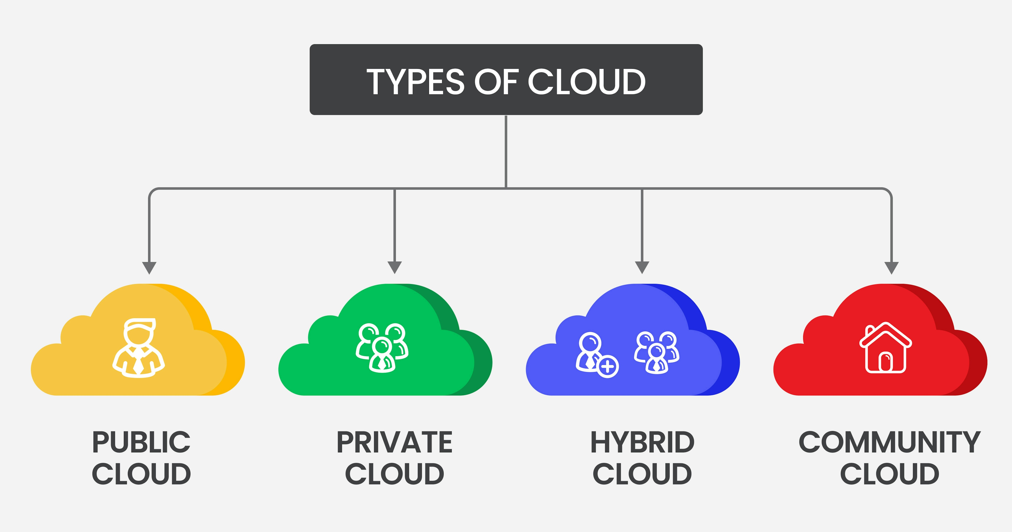
Deployment model

Slide 9
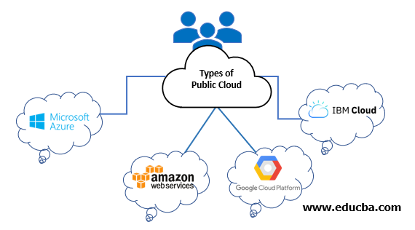
Public Cloud: Services are provided over the internet by a third-party cloud provider, and resources are shared among multiple customers.
Key Features:
Accessibility: Accessible from any internet-connected device 🌐.
Scalability: High scalability; resources can be quickly scaled up or down as needed 🔄.
Cost-Effective: Pay-as-you-go pricing model; users pay only for the resources they consume 💸.
Examples: AWS, Microsoft Azure, Google Cloud Platform.

Slide 10
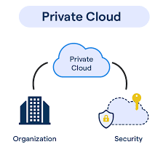
Private Cloud: A private cloud is dedicated to a single organization. It can be hosted on-premises or by a third-party provider.
Key Features:
Security: More secure as resources are dedicated solely to one organization 🔐.
Control: Greater control over the cloud environment, including security and compliance ⚙️.
Flexibility: Can be customized according to specific business needs 📊.
Examples: VMware vSphere, OpenStack.

Slide 11
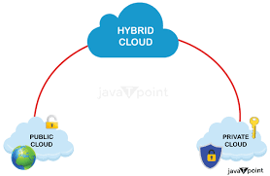
Hybrid Cloud: A combination of public and private clouds, allowing data and applications to be shared between them.
Key Features:
Flexibility: Balances scalability and control; workloads can be moved between public and private clouds based on demand 📈.
Integration: Allows existing on-premises IT resources to integrate with public cloud resources 🔗.
Data Management: Useful for companies with specific data residency requirements 📍.
Examples: Combining AWS with on-premises IT infrastructure.

Slide 12
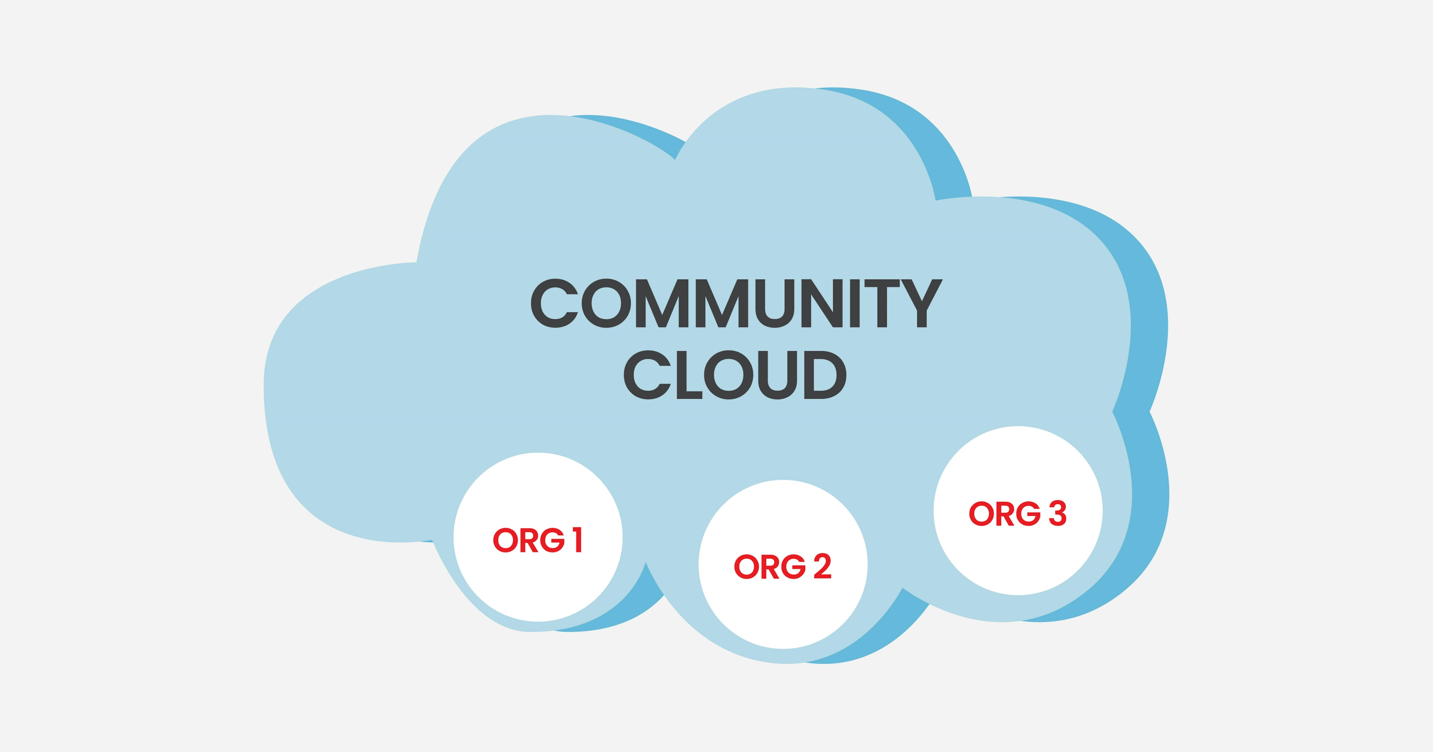
Community Cloud: Shared by several organizations with similar requirements (e.g., same industry standards).
Key Features:
Shared Goals: Cost-effective shared infrastructure for specific community use 🌐.
Security: Similar to private cloud in terms of security but shared among a group 🔒.
Compliance: Meets specific regulatory requirements for the community 📜.
Examples: A community cloud for government agencies or non-profits.

Slide 13
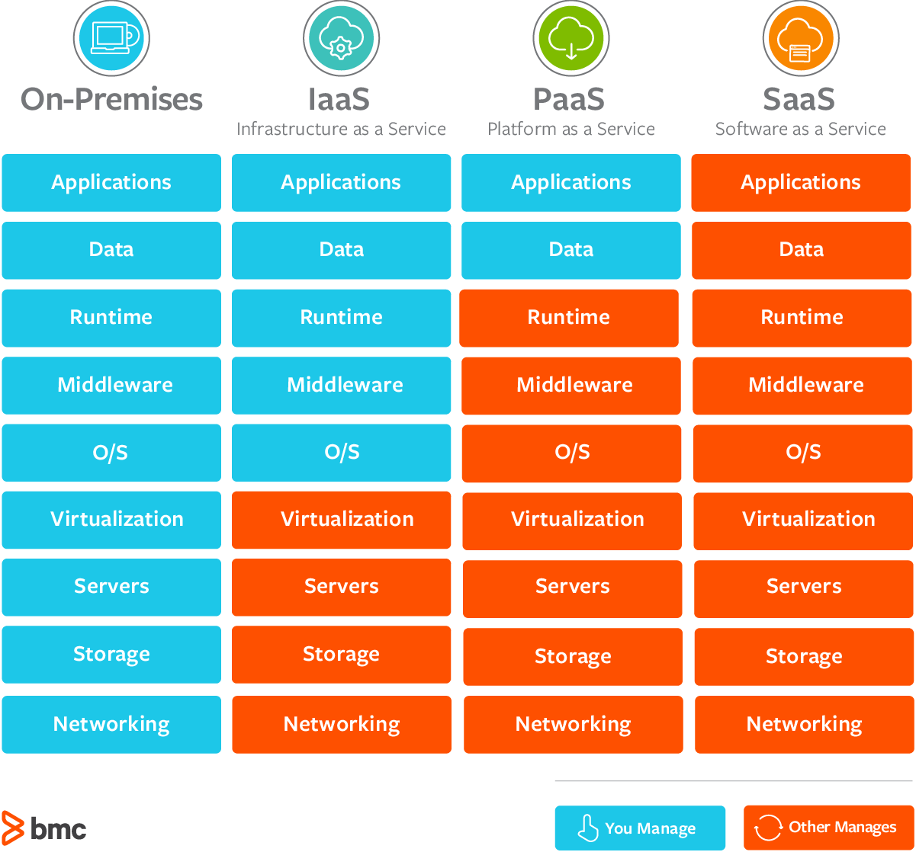
Service Models
IAAS
PAAS
SAAS

Slide 14
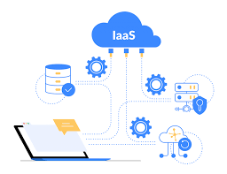
Infrastructure as a Service (IaaS): Provides virtualized computing resources over the internet. Users can rent virtual machines (VMs), storage, and networking infrastructure on an as-needed basis.
Customization: Users have control over the operating system, network configuration, and storage 🛠️.
Cost Efficiency: Pay only for the resources used 💸.
Scalability: Easily scale computing power up or down 📈.
Examples: AWS EC2, Microsoft Azure Virtual Machines, Google Compute Engine.
Imagine you want to build a new website. Instead of buying physical servers, installing operating systems, and configuring network infrastructure, you can rent these resources from a cloud provider.

Slide 15
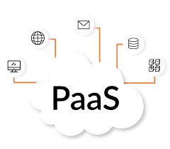
Platform as a Service (PaaS): Provides a computing platform and solution stack as a service. Users can build, run, and manage applications without dealing with the underlying infrastructure.
Development Tools: Includes development, database, and business analytics tools 🛠️.
Simplified Management: Managed environments for building applications 💼.
Scalability: Automatically scales applications 📈.
Examples: AWS Elastic Beanstalk, Microsoft Azure App Service, Google App Engine.
Imagine you're a developer wanting to build a web application. Instead of setting up servers, databases, and other infrastructure, you can use a PaaS platform to focus solely on coding your application.

Slide 16
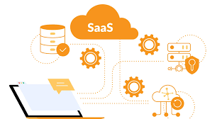
Software as a Service (SaaS): Provides software applications over the internet. The provider manages everything from infrastructure to application maintenance.
Accessibility: Accessible from any device with a web browser 🌐.
Cost-Effective: No upfront costs for software installation; subscription-based pricing 💸.
Automatic Updates: The provider handles software updates and maintenance 🔄.
Examples: Google Workspace, Microsoft 365, Salesforce.
Imagine you're a small business owner and you need a tool to manage your customer relationships, track sales, and automate marketing tasks. Instead of buying and installing software on your own computers, you can use a SaaS solution.

Slide 17
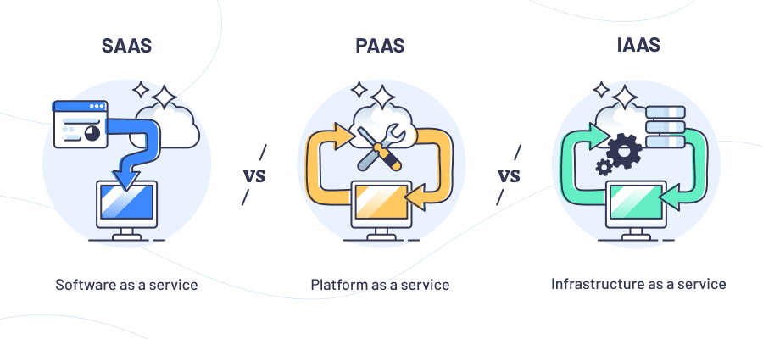
Difference between IAAS PASS SAAS

Slide 18
Feature | IaaS 🛠️ | PaaS 🚀 | SaaS 🌐
Description | Infrastructure as a Service: Rent virtualized resources like servers, storage, and networks. | Platform as a Service: Use tools to build, test, and deploy apps without managing infrastructure. | Software as a Service: Access ready-to-use applications over the internet.
Control Level | High: Full control over servers, OS, and storage. | Medium: Focus on application development, not infrastructure. | Low: Just use the application; everything else is managed.
Management | User manages OS, middleware, and runtime. | Provider manages infrastructure; user manages apps. | Provider manages everything, including maintenance and updates.
Target Users | IT administrators, developers needing flexibility. | Developers focusing on app building and testing. | End-users needing easy-to-use apps.
Examples | AWS EC2, Microsoft Azure VMs, Google Compute Engine. | AWS Elastic Beanstalk, Microsoft Azure App Service, Google App Engine. | Google Workspace, Microsoft 365, Salesforce.
Use Case | Hosting websites, data storage, disaster recovery. | Building and deploying custom apps. | Email, CRM, collaborative tools.
Setup Complexity | High 🛠️ | Medium ⚙️ | Low ✅

Slide 19
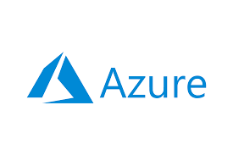

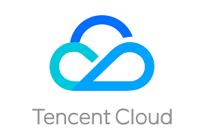
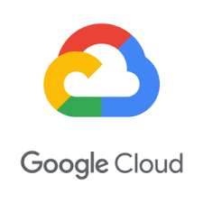
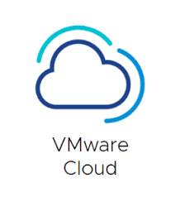
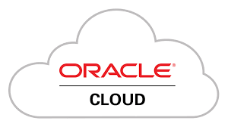


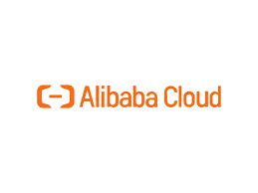
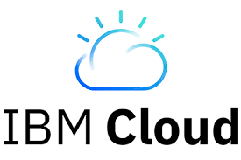
Popular cloud service providers globally

Slide 20
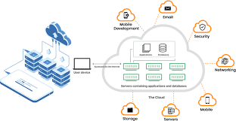
How Cloud Computing Works…?
Front End: Users interact with the cloud using web browsers, mobile apps, or other interfaces.
Back End: Data and applications are stored and processed on powerful servers located in data centers around the world.
Internet: Acts as the bridge that connects the front end to the back end.

Slide 21
Let’s see few AWS Services ….

Slide 22
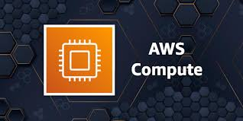
Let’s see few AWS Services ….
1. Compute Services:
AWS provides scalable and flexible compute power.
Amazon EC2: Virtual servers in the cloud for running applications.
AWS Lambda: Serverless computing to run code in response to events.
Amazon Elastic Beanstalk: Simplified application deployment and management.
Amazon ECS/EKS: Managed container services for running Docker and Kubernetes workloads.
AWS Batch: Batch processing of large-scale jobs.

Slide 23
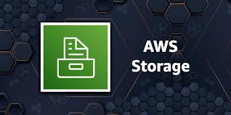
2. Storage Services
AWS offers a variety of storage solutions for different use cases.
Amazon S3: Scalable object storage for data backup and archival.
Amazon EBS: Block storage volumes for EC2 instances.
Amazon FSx: Managed file storage for Windows and Lustre.
Amazon Glacier: Low-cost storage for long-term archiving.
AWS Storage Gateway: Hybrid storage integration between on-premises and cloud.

Slide 24
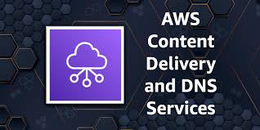
3. Networking and Content Delivery
Networking tools enable secure and fast data transfer.
Amazon VPC: Virtual Private Cloud for isolated networking.
AWS Direct Connect: Dedicated network connection to AWS.
Amazon CloudFront: Content Delivery Network (CDN) for faster content delivery.
Elastic Load Balancing: Distributes traffic across multiple instances.
AWS Route 53: Scalable Domain Name System (DNS).

Slide 25
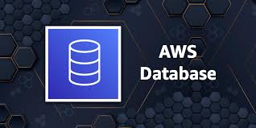
4. Database Services
AWS provides managed databases for relational, non-relational, and analytics workloads.
Amazon RDS: Managed relational database (MySQL, PostgreSQL, etc.).
Amazon Aurora: High-performance relational database engine.
Amazon DynamoDB: NoSQL database for key-value and document data.
Amazon Redshift: Data warehouse for analytics.
Amazon ElastiCache: In-memory caching for Redis and Memcached.

Slide 26
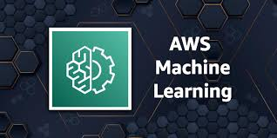
5. Machine Learning and AI
AWS offers pre-built and custom ML and AI tools.
Amazon SageMaker: Build, train, and deploy ML models.
AWS Rekognition: Image and video analysis (e.g., object and face recognition).
Amazon Polly: Converts text into lifelike speech.
Amazon Lex: Build conversational chatbots.
Amazon Forecast: Time-series forecasting.

Slide 27
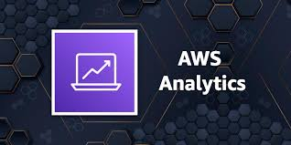
6. Analytics
Services for big data processing and analytics.
Amazon EMR: Big data processing using Hadoop and Spark.
Amazon Athena: Query data in S3 using SQL.
AWS Glue: Data integration and ETL service.
Amazon Kinesis: Real-time data streaming and analytics.
Amazon QuickSight: Business intelligence and data visualization.

Slide 28

7. Security and Identity
AWS provides tools for securing data and managing access.
AWS IAM: Manage access and permissions for AWS services.
AWS WAF: Web application firewall to protect web apps.
Amazon GuardDuty: Threat detection for AWS accounts.
AWS Shield: Protection against DDoS attacks.
AWS KMS: Managed encryption key storage.

Slide 29
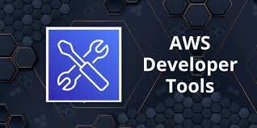
8. Developer Tools
AWS supports DevOps practices with developer tools.
AWS CodePipeline: Continuous integration and deployment (CI/CD).
AWS CodeCommit: Secure Git-based repositories.
AWS CodeBuild: Build and test code in the cloud.
AWS Cloud9: Cloud-based integrated development environment (IDE).

Slide 30
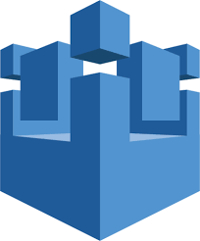
9. Internet of Things (IoT)
AWS offers IoT services for managing connected devices.
AWS IoT Core: Connect and manage IoT devices securely.
AWS Greengrass: Local computing and data management for IoT devices.
AWS IoT Analytics: Analyze IoT data at scale.

Slide 31
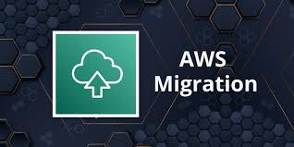
10. Migration and Transfer
AWS supports migration of applications and data to the cloud.
AWS Migration Hub: Centralized tracking for migrations.
AWS Snowball/Snowmobile: Physical devices for transferring large datasets.
AWS Database Migration Service: Migrate databases to AWS.

Slide 32
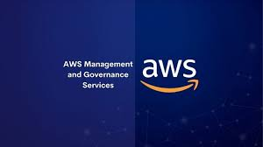
11. Management and Governance
Services to monitor, manage, and optimize AWS usage.
AWS CloudWatch: Monitoring for AWS resources and applications.
AWS CloudTrail: Logs and tracks user activity and API calls.
AWS Config: Resource inventory and compliance auditing.
AWS Auto Scaling: Automatically adjust resources to demand.

Slide 33
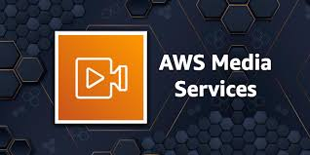
12. Media Services
AWS provides tools for creating, processing, and distributing media content.
AWS Elemental MediaLive: Live video processing and delivery.
AWS Elemental MediaConvert: File-based video transcoding.
Amazon IVS: Interactive video streaming.

Slide 34
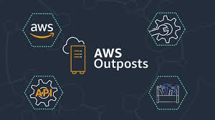
13. Hybrid Cloud
AWS enables integration with on-premises environments.
AWS Outposts: AWS services in on-premises data centers.
AWS ECS Anywhere: Run containers on local hardware.
AWS Backup: Unified backup management for hybrid environments.

Slide 35
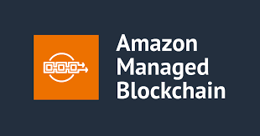
14. Blockchain
AWS supports blockchain development and management.
Amazon Managed Blockchain: Build and manage blockchain networks.
Amazon Quantum Ledger Database (QLDB): Immutable, transparent, and cryptographically verifiable ledger database.

Slide 36
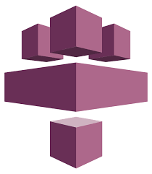
15. Game Development
AWS offers solutions for building and hosting games.
Amazon GameLift: Scalable game server hosting.
AWS Lumberyard: Free game engine integrated with AWS.

Slide 37
Let’s get started with AWS Services ….

Slide 38
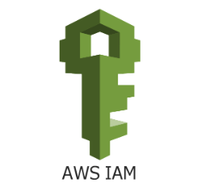
Identity and Access Management (IAM)
Identity and Access Management (IAM) is a foundational service in Amazon Web Services that helps securely manage access to AWS resources. It allows you to control who is authenticated (signed in) and authorized (has permissions) to use resources within your AWS account.

